Slide 1

CS6301-MACHINE LEARNING MINI PROJECT MUSIC GENRE CLASSIFICATION USING AUDIO
GUIDED BY:
Dr. MOHAMMED FATHIMAL
ASSISTANT PROFESSOR, DCSE
COLLEGE OF ENGINEERING, GUINDY
TEAM MEMBERS:
SHIYAM GANESH T – 2021103577
SMRITHI PRAKASH - 2021103580

Slide 2
Abstract
In a world where music intertwines intimately with the fabric of our lives and technology amplifies our connection to it, the demand for an accurate model to classify audio tracks into their distinct genres has grown significantly.
This project embarks on a harmonious journey to create such a model, orchestrating a symphony of machine learning techniques.
At its core, the classification process deftly weaves together the intricate nuances of acoustic features and spectrograms, unravelling the soul of each composition to assign it to its rightful musical genre.
Our approach is unique in that we explore a set of models, including Long-Term Short Memory(LSTM) Model, Convolutional Neural Networks(CNN), harmonizing their distinct capabilities.
Through this comparative analysis, we aim to fine-tune our model, composing a melodious harmony of precision in the realm of Music Genre Classification, and discovering the model that strikes the most accurate chord.

Slide 3
Introduction
Since the inception of music streaming services, we have had the luxury to browse and choose from a variety of music – with relevant suggestions following every song listened to.
Today, services such as Spotify and YouTube quickly create playlists and suggest the next song based on our listening patterns. These patterns are influenced by the tone, mood, or genre of songs we listen to. Several variables influence the decision, but most have to do with how the song “sounds.”
For example, a pop song might feel faster and “funkier” than, say, a romantic song; based on specific parameters that define these features, music streaming services cluster similar sounding or feeling songs into the same genre.
Thus, classifying music based on genres can help suggest the next songs to a listener, curate playlists of new recommendations, or filter undesirable content.

Slide 4
Existing System
Decision trees
A Decision Tree is a supervised machine learning algorithm used for classification tasks, including music genre classification.
It constructs a tree-like structure where each internal node represents a feature from the dataset, and each leaf node represents a class label.
The algorithm recursively splits the dataset into subsets based on the feature that provides the best separation, as determined by a criterion like information gain or Gini impurity.
The goal is to partition the data into homogenous groups, making classification decisions by following a path from the root to a leaf node in the tree.

Slide 5
Existing System
Advantages:
Interpretability: Decision Trees are highly interpretable, allowing users to understand classification logic intuitively.
Simplicity: They require minimal data pre-processing and no feature scaling, making them user-friendly.
Versatility: Decision Trees can handle numerical and categorical data, and they work well for multi-class classification, relevant to music genre classification.
Disadvantages:
Overfitting: Decision Trees are susceptible to overfitting, leading to poor generalization when the tree becomes too complex.
Limited Feature Learning: They rely on manually engineered features, which may not capture complex patterns in audio data.

Slide 6
Existing System
How CNNs Address Decision Tree’s Limitations:
Overfitting: CNNs can be effectively regularized with techniques like dropout and weight decay, preventing overfitting and promoting generalization.
Feature Learning: CNNs automatically learn relevant features from raw audio data, reducing the need for hand-crafted features, which is especially valuable for music genre classification with intricate audio patterns.

Slide 7
Existing System
K-Means Clustering
k-Means Clustering is an unsupervised machine learning algorithm that is used in music genre classification as a feature extraction and unsupervised clustering method. The process involves the following steps:
Feature Extraction: In music genre classification, the initial step is to extract relevant features from audio tracks, such as tempo, spectral characteristics, and rhythm. Each audio track is represented as a vector of these features.
Clustering Audio Tracks: Instead of directly classifying music tracks into predefined genres, k-Means clusters them into k groups based on the similarity of their feature vectors. Each cluster represents a group of audio tracks that share similar audio characteristics.
Genre Assignment: After clustering is complete, audio tracks within the same cluster are considered to belong to the same "pseudo-genre." This pseudo-genre is not predefined but is based on the unsupervised clustering of similar audio tracks.
Evaluation and Post-Processing: The results of clustering may require evaluation, and listeners may be used to identify the genre that best characterizes each cluster. Some post-processing may be necessary to refine the genre assignments or to map pseudo-genres to predefined genres if desired.

Slide 8
Existing System
Advantages:
Feature Reduction: k-Means clustering reduces the dimensionality of audio data, which aids computational efficiency and the subsequent music genre classification process.
Unsupervised Learning: The technique allows for the discovery of patterns and grouping of audio tracks without relying on predefined genre labels. This flexibility is especially useful when dealing with novel or less-defined music genres.
Disadvantages:
Interpretability: Assigning meaningful genre labels to the clusters created by k-Means can be challenging and subjective, as it may require human judgment to match pseudo-genres with established genre labels.
Subjectivity: The choice of the number of clusters (k) is subjective and may require experimentation to determine the optimal value.

Slide 9
Existing System
How CNNs Address k-Means' Limitations:
Interpretability: CNNs are typically used in supervised learning, where genre labels are predefined. They offer a more straightforward and interpretable output by directly associating audio tracks with predefined genre labels, reducing interpretational challenges.
Subjectivity: CNNs rely on predefined genre labels, diminishing subjectivity in the process of assigning pseudo-genres to clusters. The use of CNNs in music genre classification follows a supervised approach with established ground truth labels, enhancing clarity and objectivity in music track categorization.

Slide 10
Problem Definition
Music genre classification is an important task in the field of music information retrieval.
It involves the automatic identification and classification of music into different genres based on their audio features.
Music genre classification has several real-world applications, including music recommendation, content-based music retrieval, and personalized music services.
However, the task of music genre classification is challenging due to the subjective nature of music and the complexity of audio signals.
Traditional methods for music genre classification suffer from low accuracy, which limits their practical applications.
Therefore, there is a need for more accurate and robust methods for music genre classification that can handle the diversity and complexity of music.
The problem statement for this research is to propose different models for music genre classification that can achieve high accuracy on the GTZAN Dataset.

Slide 11
Problem Definition
There are several problem statements in music genre classification in machine learning that researchers have been addressing. Some of the key problems include:
Handcrafted feature extraction: Traditional music genre classification methods require manually extracting features from audio signals, which is a time-consuming and complex process. Features extracted may not be effective.
High-dimensional data: Audio signals are high-dimensional and require large amounts of storage and processing power, which can be a challenge for some machine learning algorithms.
Inter-genre similarity: Some music genres may have similar acoustic features, which makes it difficult for a machine learning model to distinguish between them.
Real-time classification: Real-time classification of audio signals for music genre identification requires fast and efficient machine learning algorithms that can process the audio data in real- time.

Slide 12
Objective
The primary objective of our project is to create a practical and efficient system for automatically categorizing music tracks into genre labels based on their audio features.
This system aims to provide valuable insights into the genre composition of a music collection, making it a valuable tool for music enthusiasts, radio stations, streaming platforms, and music recommendation systems.

Slide 13
Key goals of the project
Genre Classification: To build a machine learning model that can classify audio tracks into distinct music genres, such as rock, jazz, classical, hip-hop, and more.
Feature Extraction: To extract relevant acoustic features, such as MFCCs (Mel-frequency cepstral coefficients), spectral contrast, and chroma features, from audio signals.
Model Training: To train and fine-tune machine learning models, including deep neural networks, to learn and recognize patterns within the extracted audio features.
Evaluation: To rigorously evaluate the performance of the classification model using appropriate metrics, such as accuracy, precision, recall, and F1-score.
Real-world Applicability: To demonstrate the real-world applicability of the system by classifying a diverse dataset of audio tracks across different genres.
User Interface: To provide a user-friendly interface for users to interact with the classification system, allowing them to upload audio tracks and receive genre predictions.

Slide 14
Literature Review
Papers | Algorithm Used | Disadvantages
Tzanetakis, G. and Cook, P. (2002) Musical Genre Classification of Audio Signals.^{[1]} | Gaussian Mixture Model Classifier | 1.Assumption of Gaussian Distribution 2.Difficulty with High-Dimensional Data 3.Sensitivity to Initialization 4.Limited Representation of Temporal Dynamics 5. Difficulty in Capturing Non-Linear Relationships
Changsheng Xu, N. C. Maddage, Xi Shao, Fang Cao and Qi Tian, "Musical genre classification using support vector machines," 2003^{[2]} | SVM | 1..Sensitivity to parameter tuning. 2.Computational complexity for large datasets. 3.Difficulty handling high-dimensional feature spaces. 4.Limited robustness to noisy data and outliers. 5.Challenges with imbalanced datasets. 6.Lack of interpretability, especially with non-linear kernels.
M. Shah, N. Pujara, K. Mangaroliya, L. Gohil, T. Vyas and S. Degadwala, "Music Genre Classification using Deep Learning," 2022 6th International Conference on Computing Methodologies and Communication (ICCMC), Erode, India, 2022, pp. 974-978^{[3]} | Random Forest | 1.Parameter Sensitivity 2.Computational Complexity 3.High-Dimensional Data 4.Sensitivity to Noise 5.Imbalanced Datasets 6.Interpretability Issues 7.Temporal Dynamics

Slide 15
Hardware Specifications
Processor: Intel Core i5 or i7, or AMD Ryzen 5 processors.
RAM: A minimum of 8GB of RAM
Storage: 500GB or larger SSD
GPU : NVIDIA GTX or RTX series with dedicated VRAM

Slide 16
Software Specifications
Python: Python 3.x
Audio Processing Libraries: Librosa or Essentia.
Machine Learning Libraries: scikit-learn, TensorFlow
Development Environment: Jupyter Notebook, Visual Studio Code
Version Control: Git

Slide 17
Proposed Project Summary
Objective:
This project is centred around developing a sophisticated music genre classification system leveraging advanced machine learning models. The primary focus is on three distinct models: Long Short-Term Memory (LSTM), Convolutional Neural Network (CNN), and k-Nearest Neighbours (K-NN). The goal is to create a robust system capable of real-time genre predictions, with an intuitive user interface developed using Stream lit.
Implemented Models:
Long Short-Term Memory (LSTM):
- Objective: Designed to capture sequential dependencies in audio features, particularly well-suited for recognizing patterns over extended timeframes inherent in music.
- Key Features:
- Incorporates memory cells and gating mechanisms for nuanced temporal feature capture.
- Effective in handling complex relationships in the temporal domain, such as rhythm and melodic changes.

Slide 18
Proposed Project Summary
2. Convolutional Neural Network (CNN):
- Objective: Utilized for learning hierarchical features from audio spectrograms, focusing on capturing complex patterns and variations in audio data.
- Key Features:
- Employs convolutional layers to automatically identify both local and global audio characteristics.
- Particularly effective in processing spectrogram data, allowing for the extraction of intricate spectral features.
3. k-Nearest Neighbours (K-NN):
- Objective: Simplicity meets effectiveness in classifying based on feature proximity, providing a different perspective on genre prediction
- Key Features:
- Makes predictions based on the majority class of its k-nearest neighbours, emphasizing localized decision-making.
- Offers simplicity, interpretability, and sensitivity to local feature relationships.

Slide 19
Proposed Project Summary
User Interface:
The user interface is developed using stream lit, offering an engaging and intuitive platform for users to interact with the music genre classification system.
- Audio File Upload:
- Users can seamlessly upload audio files for real-time genre prediction.
- Interactive Graphical Output:
- Predictions are visually represented through an interactive graph, displaying the probabilities of the audio belonging to different genres.
- User Engagement:
- The stream lit interface ensures a user-friendly experience, making genre prediction accessible to a broad range of users.
Technology Stack:
- Language Used: Python
- Machine Learning Libraries: TensorFlow, Keras, Scikit-learn
- User Interface: streamlit
- Audio Processing: Librosa
- Data Manipulation: Pandas, NumPy
- Visualization: Matplotlib

Slide 20
Proposed Project Summary
Key Features:
Multi-Model Approach:
- Integration of LSTM, CNN, and K-NN provides diverse perspectives on music genre classification, enhancing overall model robustness.
- Each model contributes a unique set of capabilities, enriching the system's understanding of audio features.
2. Real-Time Prediction:
- Users experience immediate predictions upon uploading audio files, offering an interactive and responsive platform for genre analysis.
3. Probabilistic Graphical Output:
- Genre predictions are visually represented through an interactive graph, allowing users to interpret and understand the confidence levels associated with each prediction.
4. Scalability:
- The system is designed to handle various audio formats and scales efficiently with differing dataset sizes, ensuring flexibility and adaptability.

Slide 21
Proposed Project Summary
Future Enhancements:
1. Ensemble Learning:
- Consideration of ensemble learning techniques to amalgamate predictions from multiple models, potentially improving overall classification accuracy.
2. Expand Genre Support:
- Inclusion of a broader range of music genres to make the system more versatile and applicable to diverse musical preferences.
3. Real-Time Training:
- Implementation of mechanisms for continuous learning to adapt the models to evolving musical trends and patterns.
4. User Feedback Integration:
- Integration of user feedback mechanisms to gather insights on predictions, facilitating model refinement and improvement over time.

Slide 22
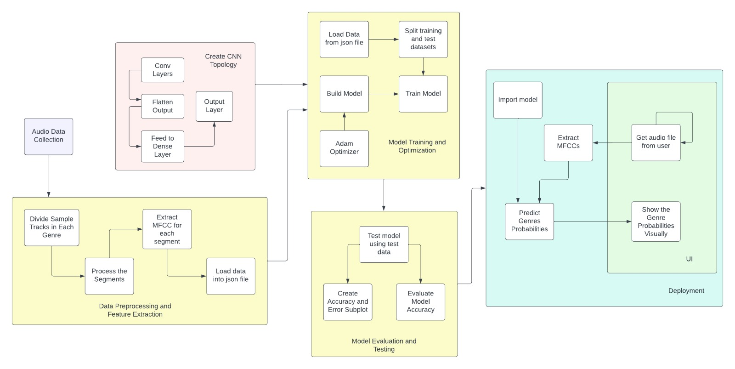
Architecture Diagram

Slide 23
Technical Modules
1.User Interface Design
1.1.Upload Music File
1.2.Get Predicted Output
2.Training
2.1.Models Used-Convolutional Neural Networks (CNN), K-Nearest Neighbors (KNN), Long Term Short Memory (LSTM)
2.1.1.Feature Extraction
2.1.2.Train and Test Data Split
2.1..2.Fitting the Model
3.Testing
3.1.Predict using test dataset
3.2.Calculate Accuracy
3.3.Calculate F1-Score
3.4.Display Confusion Matrix

Slide 24

Technical Modules
1.User Interface Design
Input:
The user interacts with the system by providing an audio file in standard formats such as MP3 or WAV. This file serves as the input to the music genre classification system.
Interface for Uploading Audio File

Slide 25
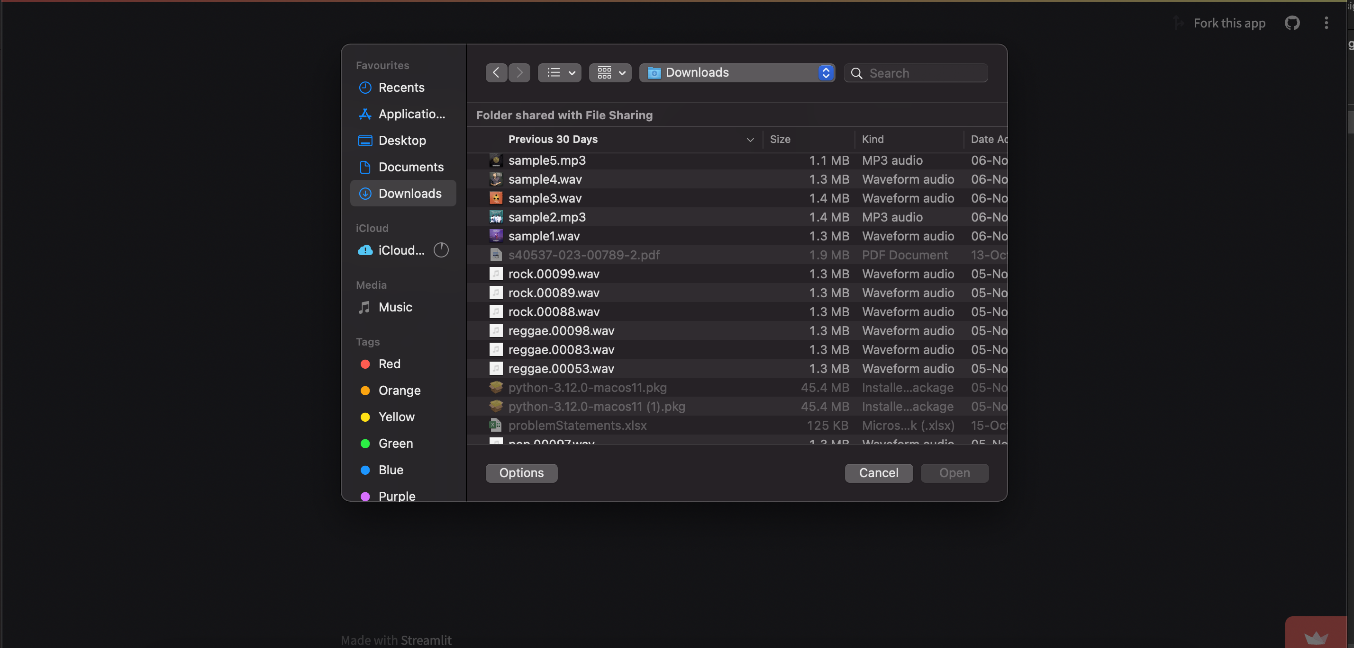
Technical Modules
Selecting audio file

Slide 26
Technical Modules
User Interface Framework:
The user interface is developed using Streamlit, a Python library for creating web applications with minimal code.
Streamlit facilitates a seamless and intuitive experience for users to interact with the system.

Slide 27
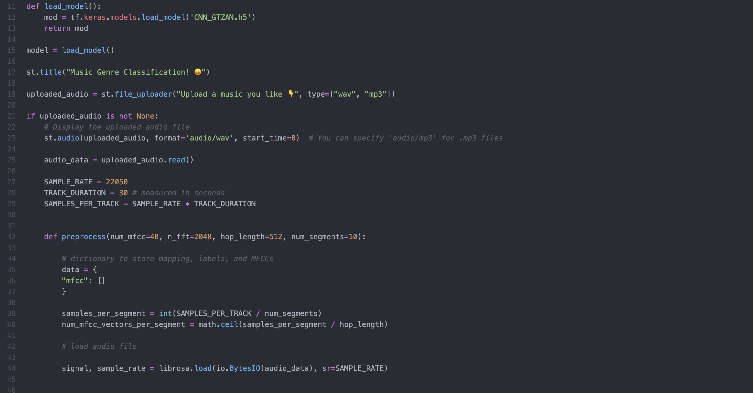
Technical Modules
Streamlit Code Snippet

Slide 28
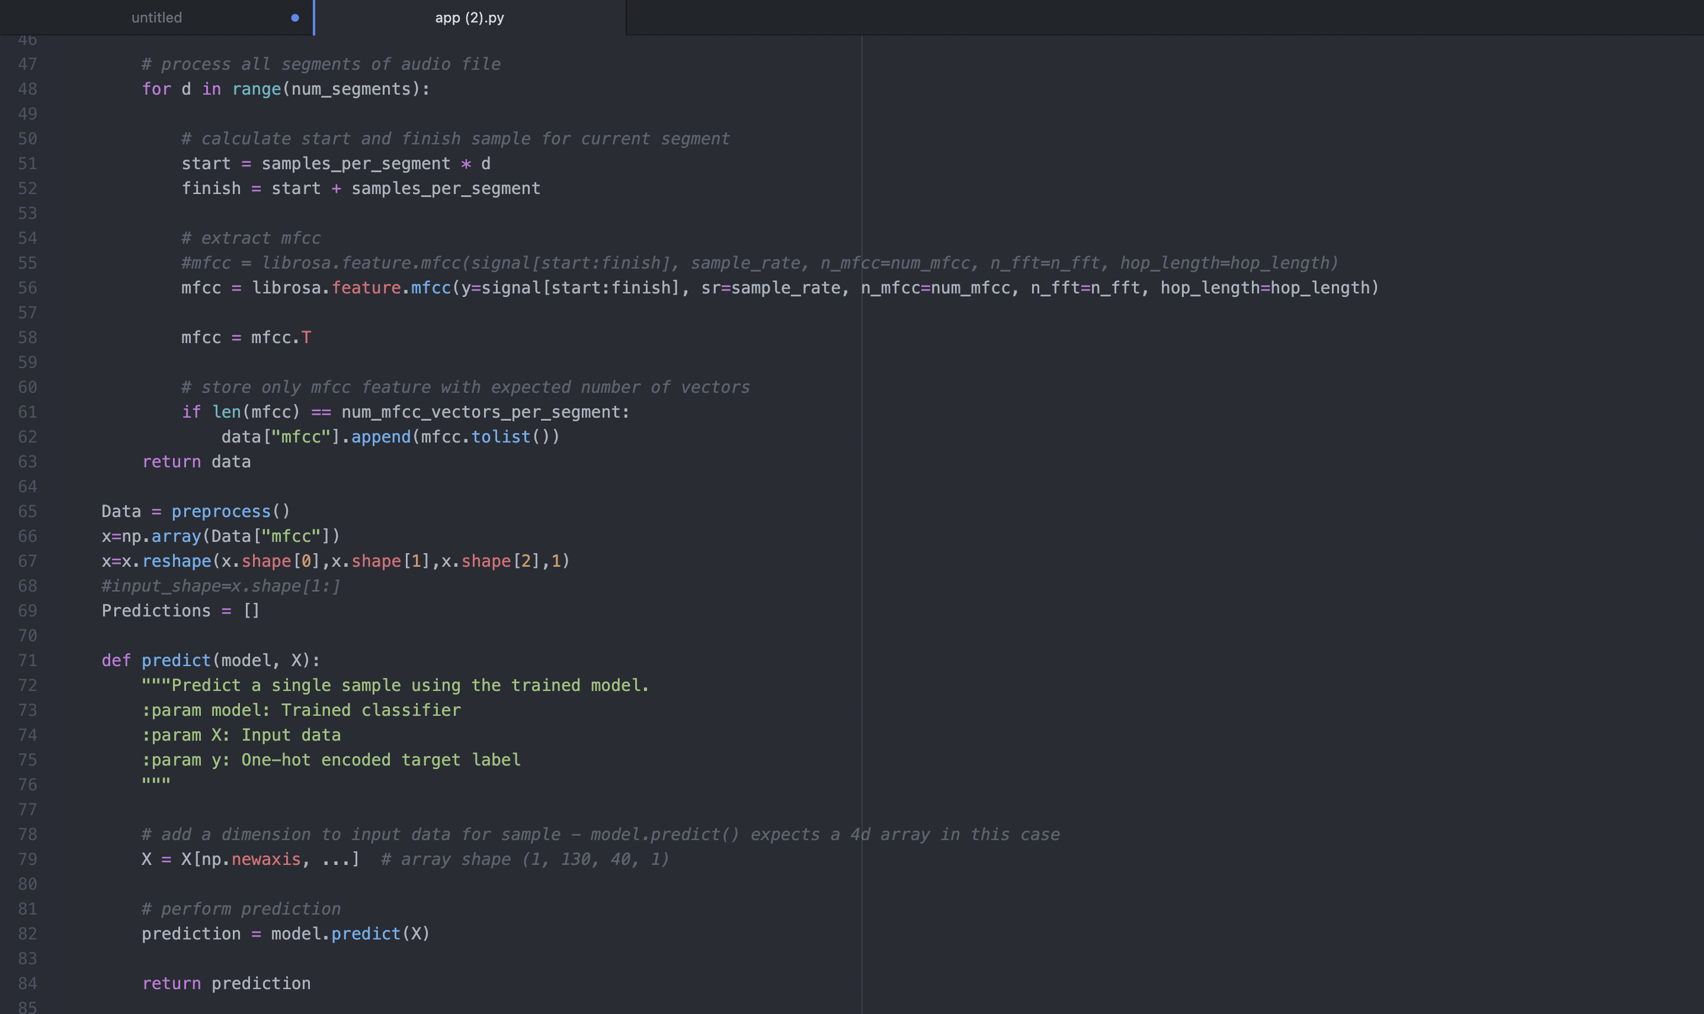
Technical Modules
Streamlit Code Snippet

Slide 29
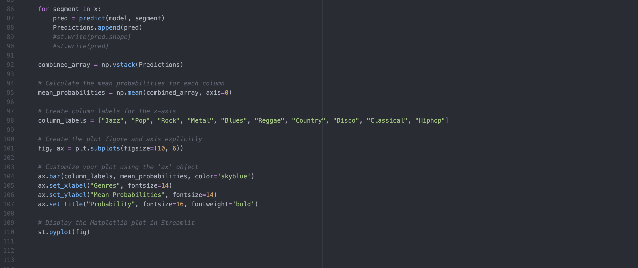
Technical Modules
Streamlit Code Snippet

Slide 30
Technical Modules
Input Interface:
A dedicated section of the user interface allows users to upload their audio file effortlessly.
The file upload widget ensures a straightforward input process, enabling users to submit their music files for genre classification
Processing Feedback:
To enhance user experience, the system provides clear and concise feedback during the processing stage. Users are informed about the ongoing analysis, ensuring transparency and responsiveness.
This feedback may include a loading indicator or a status message.
Algorithm Integration:
Behind the scenes, the input audio file undergoes pre-processing steps and is fed into the trained machine learning model (CNN)
The integration is seamless, and users are shielded from the complexities of the underlying classification algorithm.

Slide 31
Technical Modules
Output Display:
Upon completion of the analysis, the system presents the results through a graphical representation on the user interface.
A visually appealing graph, such as a bar chart, is generated to depict the probability distribution of the input song across ten music genres.
Interpretation:
The displayed graph allows users to interpret the model's predictions easily. Each genre is labelled on the x-axis, and the corresponding probabilities are indicated on the y-axis.
This design choice ensures a user-friendly presentation of results.

Slide 32
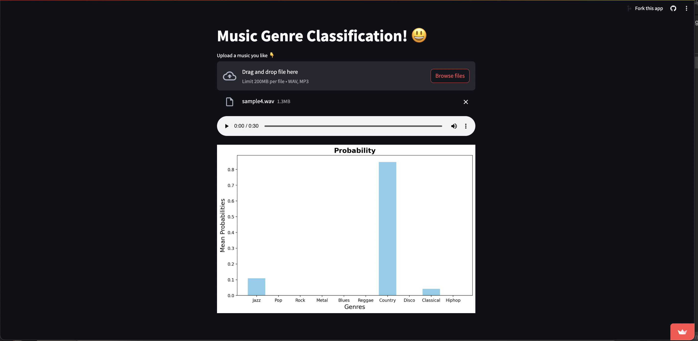
Technical Modules
Predicted Result

Slide 33
Technical Modules
2.Training
Input- Dataset
Dataset Description
The dataset that is used in the project is the GTZAN Genre Classification dataset which consists of 1,000 audio tracks, each 30 seconds long with their corresponding genre labels. It contains 10 genres, each represented by 100 tracks.
The 10 genres are as follows: Blues, Classical, Country, Disco, Hip-hop, Jazz, Metal, Pop, Reggae and Rock
The dataset has the following folders:
Genres original — A collection of 10 genres with 100 audio files each, all having a length of 30 seconds (the famous GTZAN dataset, the MNIST of sounds)
Images original — A visual representation(Mel Spectrogram) for each audio file.
2 CSV files — Containing features of the audio files. One file has for each song (30 seconds long) a mean and variance computed over multiple features that can be extracted from an audio file. The other file has the same structure, but the songs are split before into 3 seconds audio files.

Slide 34
Technical Algorithms
Model 1- Convolutional Neural Networks
Algorithm:
One of the proposed algorithms for this project is based on Convolutional Neural Networks (CNNs) and utilizes Mel-Frequency Cepstral Coefficients (MFCCs) as a feature representation. This combination is a powerful approach for music genre classification. In this context, MFCCs are employed as a feature extraction technique for audio data. Here's how CNNs and MFCCs work together:
Feature Extraction with MFCCs : Raw audio data is initially processed to compute MFCCs. MFCCs capture essential characteristics of the audio, including timbre, spectral content, and rhythm, which are crucial for distinguishing music genres.
Data Preparation : The extracted MFCCs are organized into feature vectors, which serve as the input data for the CNN model. Each feature vector represents a segment of the audio track.

Slide 35
Technical Modules
CNN Architecture : The CNN architecture includes convolutional layers designed to understand spatial patterns within the MFCCs. These layers effectively recognize variations in the audio features across different music genres.
Pooling and Flattening: Similar to the previous explanation, pooling layers are employed to reduce spatial dimensions. The feature maps are then flattened into a one-dimensional vector.
Fully Connected Layers: These layers connect the flattened feature vector to the output layer, where the model makes predictions about the music genre.
Model Architecture: Once the Convolutional Neural Network (CNN) architecture is defined, the next step is to train the model using the music dataset.

Slide 36
Technical Modules
Dataset Split: The dataset is typically divided into three subsets: a training set, a validation set, and a test set. The training set is used to teach the model, the validation set helps fine-tune it, and the test set evaluates its performance.
Training Process: During training, the CNN learns to recognize patterns and features in the Mel-Frequency Cepstral Coefficients (MFCCs) extracted from audio tracks. This process involves adjusting the model's internal parameters to minimize prediction errors.
Validation: Periodically, the model's performance is assessed using the validation set. This helps ensure that the model is not overfitting to the training data, as it needs to generalize well to new, unseen music tracks.
Evaluation Metrics: To gauge the model's effectiveness, standard evaluation metrics are employed.

Slide 37

Technical Modules
Dataset Loading, Feature Extraction, Train-Test-Split

Slide 38
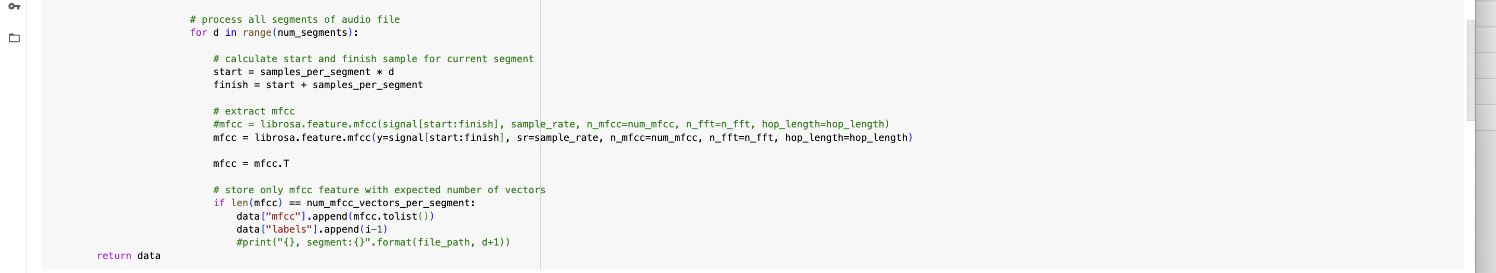
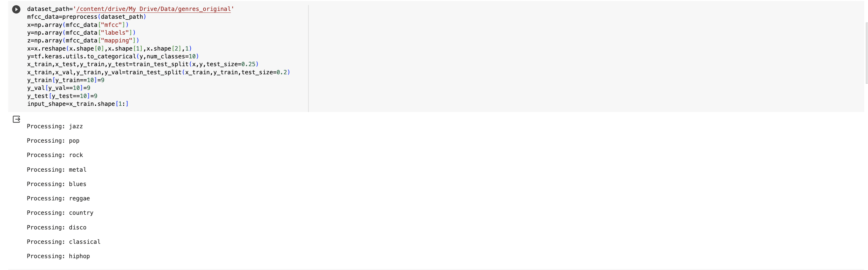
Technical Modules
Dataset Loading, Feature Extraction, Train-Test-Split

Slide 39
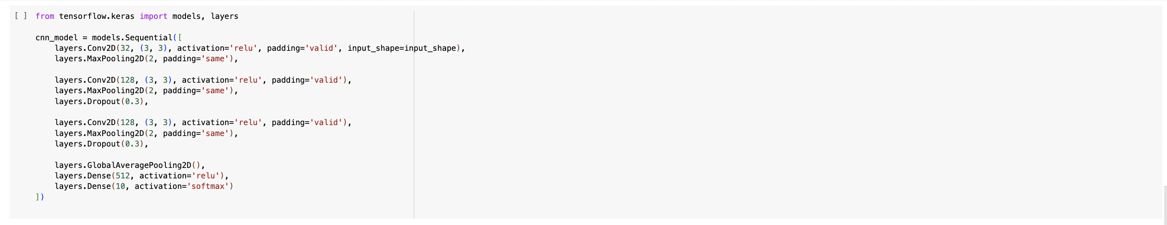
Technical Modules
Model Architecture

Slide 40
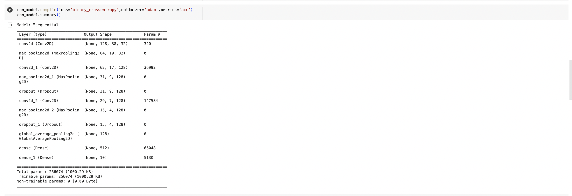
Technical Modules
Compiling the Model

Slide 41
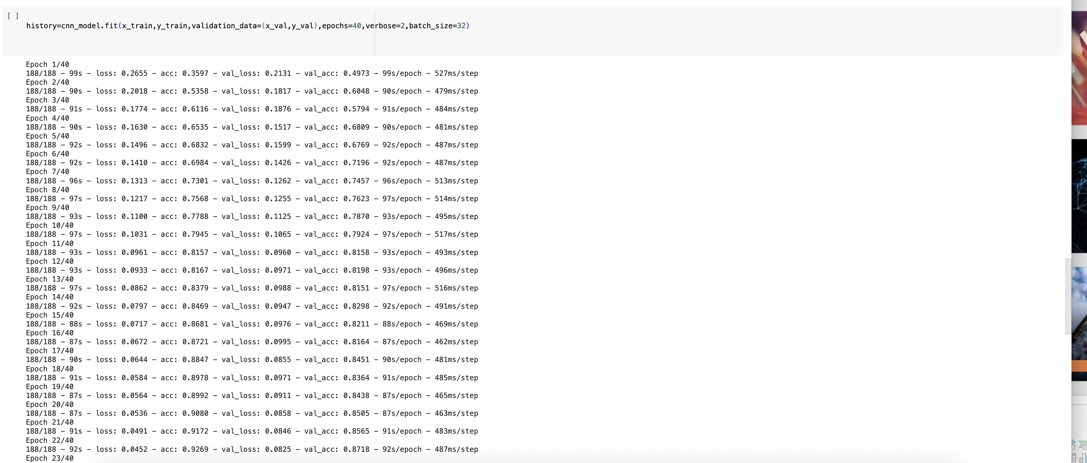
Technical Modules
Fitting the model

Slide 42
Technical Modules
Model 2- Long Short-Term Memory(LSTM)
Data Setup: The music files are stored in a specific location (Google Drive is used in the provided code). Each genre of music has its own sub-folder.
Preprocessing: Here, the audio files are loaded and segmented. For each segment, Mel-frequency cepstral coefficients (MFCCs) are computed. MFCCs are a type of spectral feature that has proven to be highly effective for audio classification tasks. These coefficients capture the power spectrum of an audio signal and are a good representation of its timbral texture.
Data Organization: The MFCCs and corresponding labels (genres) are stored in a dictionary. Each label corresponds to a genre sub-folder.
Data Splitting: The data is then split into training, validation, and testing sets. This is done to evaluate the performance of the model later.
Model Building: A Long Short-Term Memory (LSTM) model is built using Keras. The model consists of two LSTM layers and two Dense layers. The LSTM layers are designed to capture the temporal dependencies in the music data, while the Dense layers perform the actual classification.

Slide 43
Technical Modules
Model Training: The model is trained using the training set, with the validation set used to tune the model parameters to prevent overfitting.
Model Evaluation: After training, the model is evaluated using the testing set. The model's performance is measured in terms of its accuracy, which is the proportion of correct predictions made by the model.
Prediction: The trained model is then used to predict the genre of new, unseen music files. The prediction is made by feeding the MFCCs of the audio file into the model, which outputs a predicted genre.
Performance Metrics: Finally, other performance metrics like the F1 score and confusion matrix are computed. The F1 score is a measure of the model's accuracy considering both precision and recall. The confusion matrix shows the number of correct and incorrect predictions made by the model, broken down by each class.

Slide 44
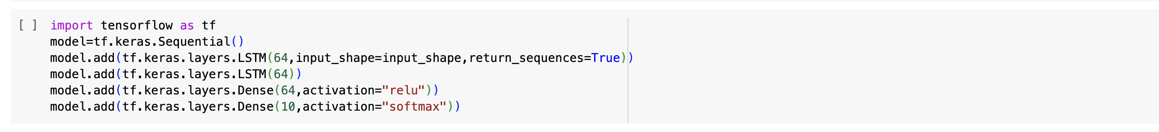
Technical Modules
LSTM Architecture

Slide 45
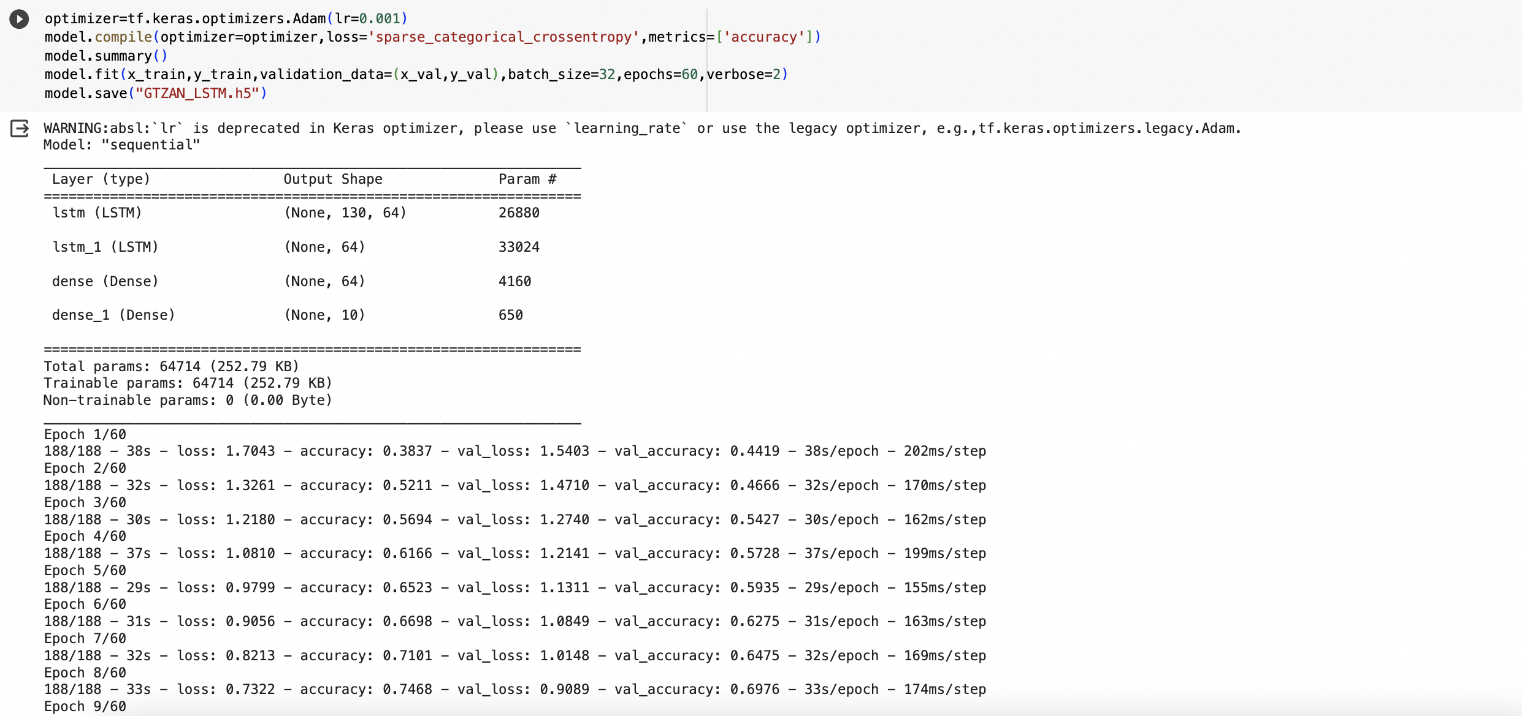
Technical Modules
Compiling and Fitting the model

Slide 46
Technical Modules
Model 3- K Nearest Neighbours Algorithm (KNN)
Algorithm:
Load and Pre-process Data: Load the audio data and extract relevant features. Common features for music include Mel-frequency cepstral coefficients (MFCCs), spectral contrast, tempo, and rhythm patterns.
Feature Scaling: Standardize or normalize the feature values. This step is essential for distance-based algorithms like KNN.
Split Data: Divide the dataset into training and testing sets. A common split is around 70-80% for training and the remaining for testing.
Choose the Number of Neighbors (K): Decide on the number of neighbors (K) to consider when making predictions. This parameter is crucial and can be chosen through techniques like cross-validation.
Train the KNN Model: Train the KNN classifier using the training data. The model stores the feature vectors and their corresponding labels.

Slide 47
Technical Modules
Predictions: For each instance in the test set, find the K training instances closest to it based on the chosen distance metric (e.g., Euclidean distance).
Majority Voting: Assign the class label to the test instance based on majority voting from its K nearest neighbours.
Evaluate Performance: Assess the performance of the model using metrics such as accuracy, precision, recall, and F1 score on the test set.
Parameter Tuning: Experiment with different values of K and other hyperparameters to optimize the model's performance. Consider using techniques like grid search or cross-validation.

Slide 48
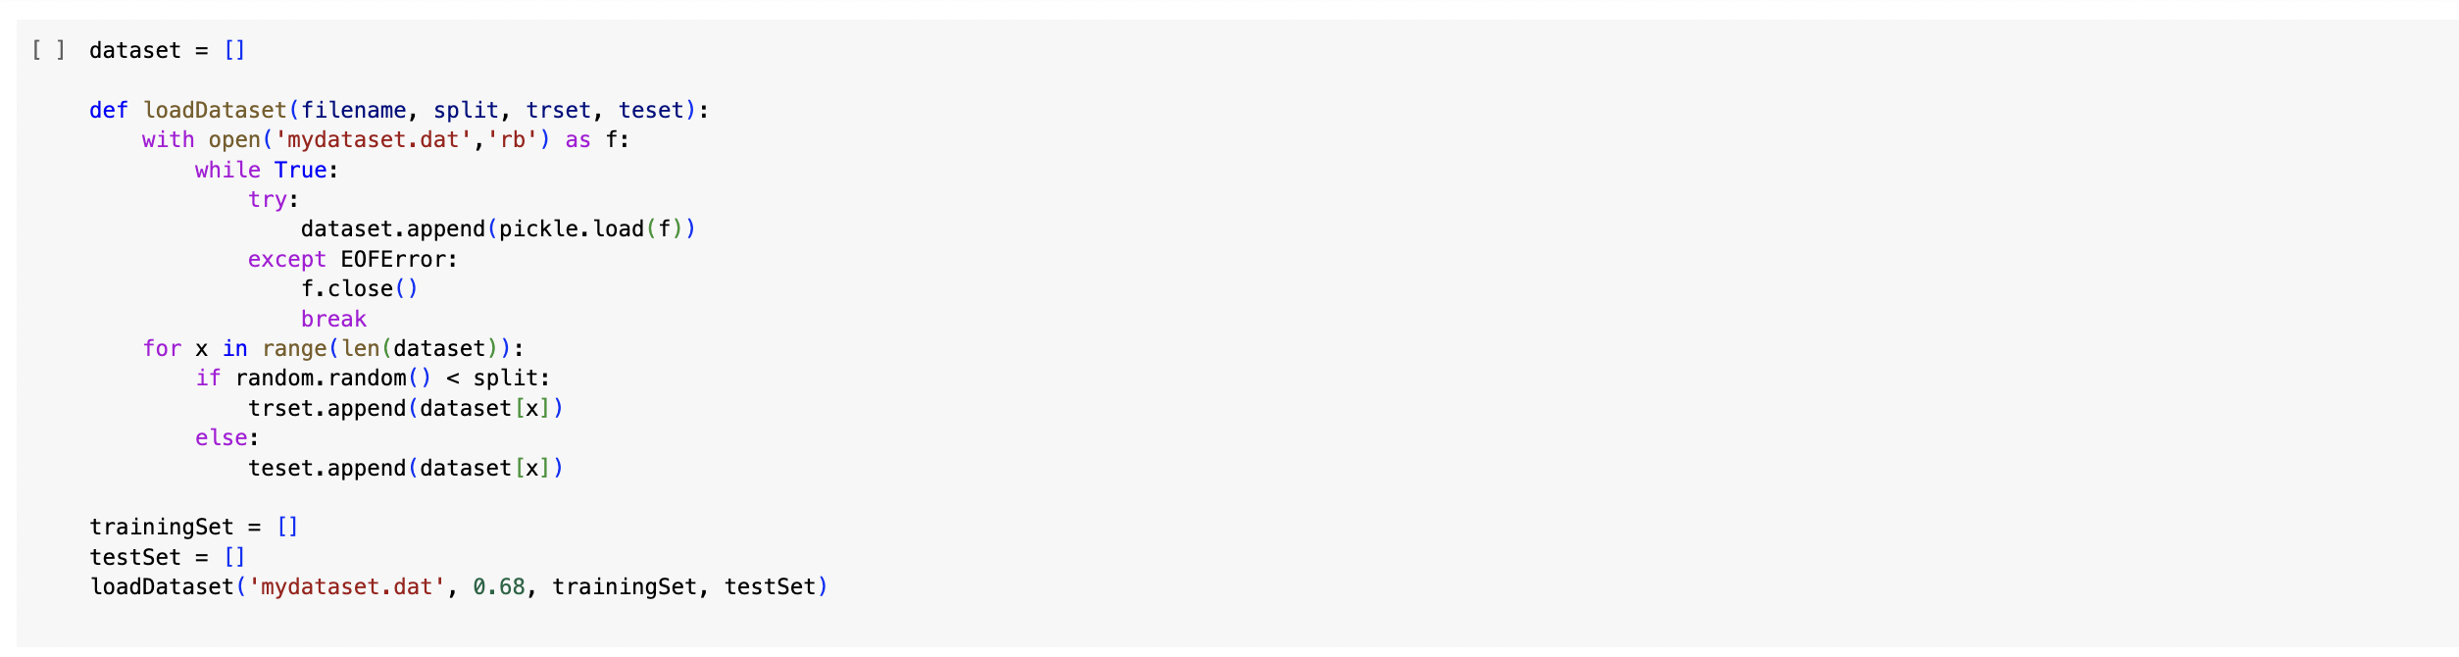
Technical Modules
Dataset Loading

Slide 49

Technical Modules
Data preprocessing and feature extraction

Slide 50
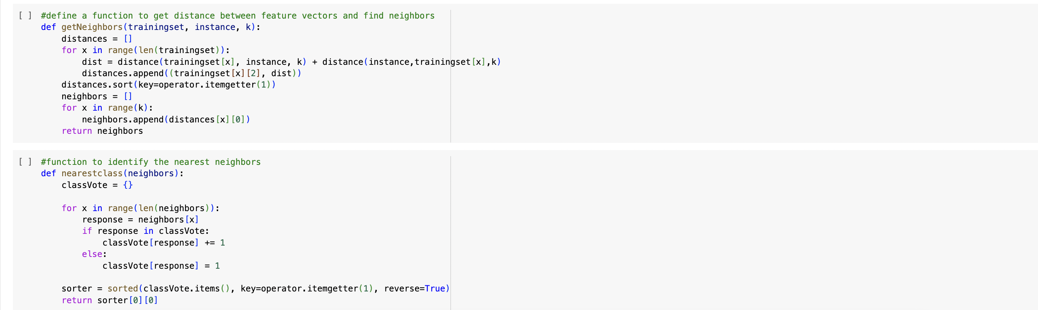
Technical Modules
KNN implementation

Slide 51
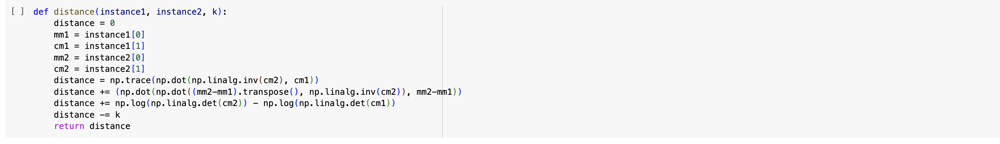
Technical Modules
KNN implementation

Slide 52
Technical Modules
3.Testing
In this phase, the three models are tested and their accuracy, F1-Score and confusion matrix are generated.
Convolutional Neural Networks
Accuracy

Slide 53
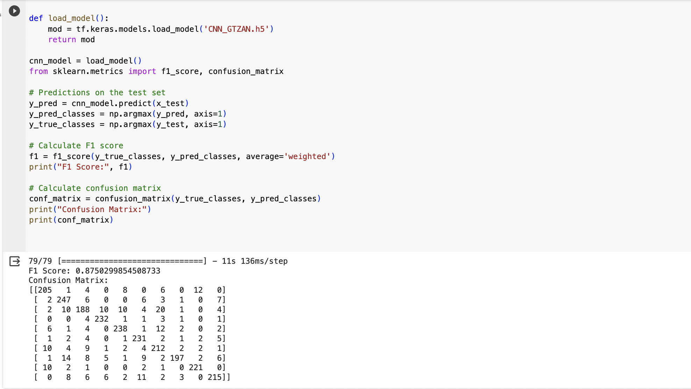
Technical Modules
F1 Score and Confusion Matrix

Slide 54
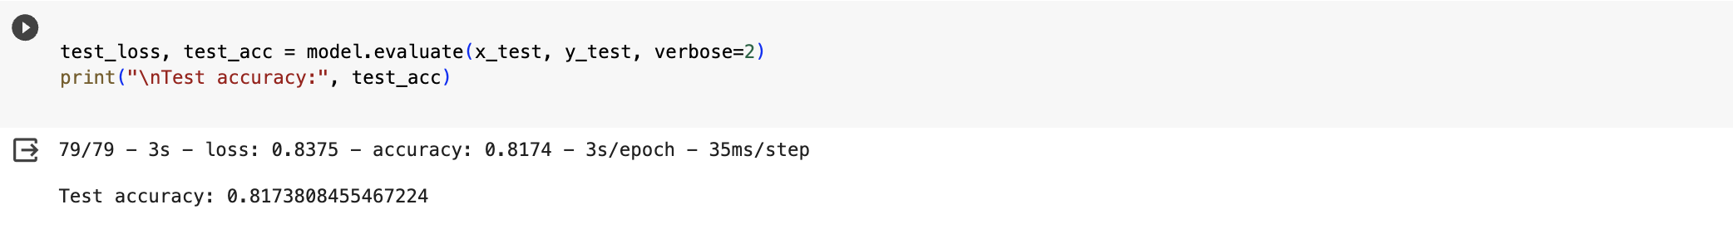
Technical Modules
Long Short-Term Memory
Accuracy

Slide 55
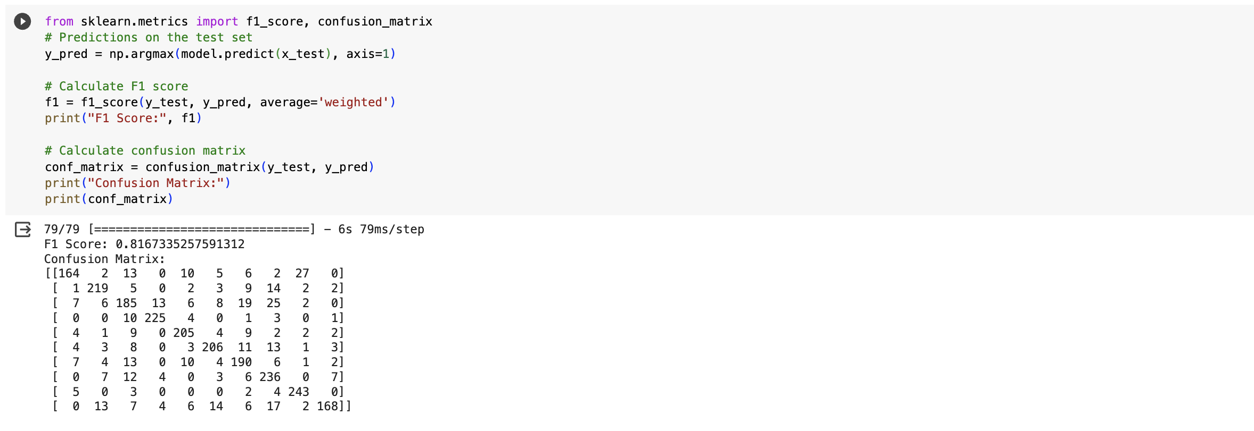
Technical Modules
F1 Score and Confusion Matrix

Slide 56
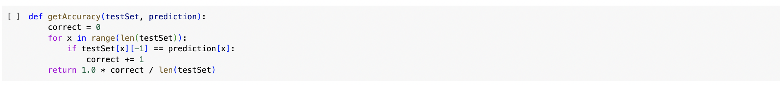
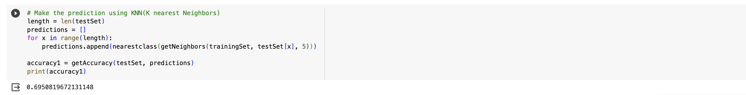
Technical Modules
K Nearest Neighbors Algorithm
Accuracy Calculation
Accuracy

Slide 57
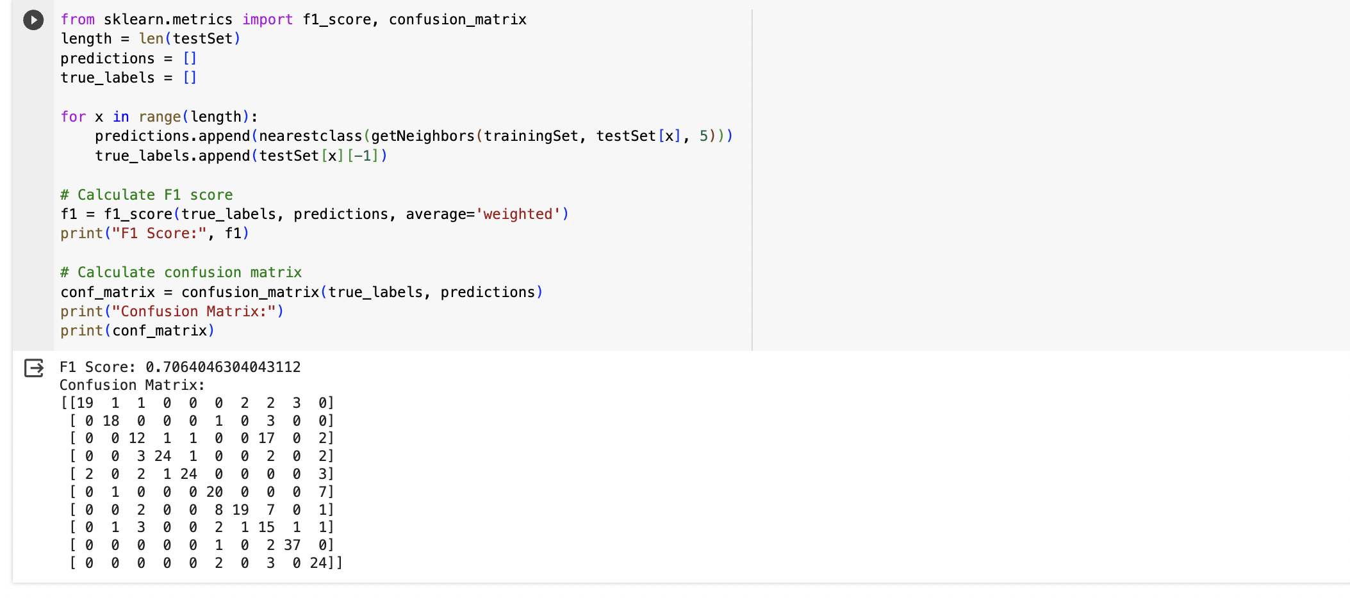
Technical Modules
F1 Score and Confusion Matrix

Slide 58
Performance Metrics
1.Accuracy Score:
Accuracy measures the ratio of correctly predicted instances to the total number of instances in a classification problem. It provides a general idea of how well the model is performing.
Formula:
Accuracy = (True Positives + True Negatives) / (True Positives + True Negatives + False Positives + False Negatives)
2. F1 Score:
The F1 score is a metric that considers both precision and recall. It is the harmonic mean of precision and recall and is particularly useful when the class distribution is imbalanced.
Formula:
F1 Score = 2 * (Precision * Recall) / (Precision + Recall)
Where:
- Precision = True Positives / (True Positives + False Positives)
- Recall (Sensitivity) = True Positives / (True Positives + False Negatives)

Slide 59

Performance Metrics
3. Confusion Matrix:
A confusion matrix is a table that is often used to describe the performance of a classification model. It provides a breakdown of true positives, true negatives, false positives, and false negatives.
- True Positives (TP): The number of correctly predicted positive instances.
- True Negatives (TN): The number of correctly predicted negative instances.
- False Positives (FP): The number of negative instances incorrectly predicted as positive (Type I error).
- False Negatives (FN): The number of positive instances incorrectly predicted as negative (Type II error).

Slide 60
References
Tzanetakis, G. and Cook, P. (2002) Musical Genre Classification of Audio Signals. IEEE Transactions on Speech and Audio Processing, 10, 293-302. https://doi.org/10.1109/TSA.2002.800560
Changsheng Xu, N. C. Maddage, Xi Shao, Fang Cao and Qi Tian, "Musical genre classification using support vector machines," 2003 IEEE International Conference on Acoustics, Speech, and Signal Processing, 2003. Proceedings. (ICASSP '03)., Hong Kong, 2003, pp. V-429, doi: 10.1109/ICASSP.2003.1199998.
doi:10.1109/ICASSP.2003.1199998
M. Shah, N. Pujara, K. Mangaroliya, L. Gohil, T. Vyas and S. Degadwala, "Music Genre Classification using Deep Learning," 2022 6th International Conference on Computing Methodologies and Communication (ICCMC), Erode, India, 2022, pp. 974-978,
doi: 10.1109/ICCMC53470.2022.9753953.

Slide 61
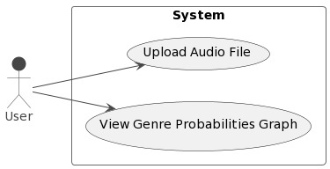
Use Case Diagram

Slide 62
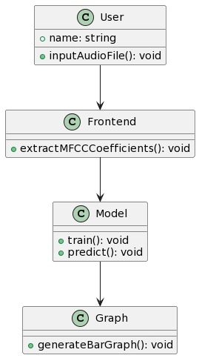
Class Diagram

Slide 63
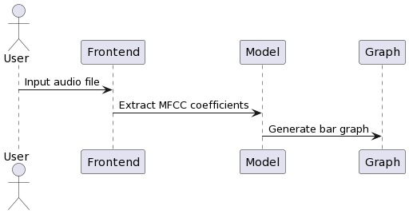
Sequence Diagram

Slide 64
Conclusion
In conclusion, the music genre classification project involved the comparison of three models—Convolutional Neural Network (CNN), Long Short-Term Memory (LSTM), and K-Nearest Neighbours (KNN).
Through rigorous evaluation, it was observed that the CNN model exhibited higher accuracy compared to the other models.
The CNN's ability to automatically extract hierarchical features from audio data, particularly when represented using Mel-frequency cepstral coefficients (MFCCs), contributed to its superior performance.
While the LSTM model demonstrated temporal sequence learning, and KNN provided interpretability, they fell short of the accuracy achieved by the CNN.
The project also featured a user interface implemented using Streamlit, which facilitated easy model usage by allowing users to input audio files for genre predictions, primarily powered by the high-performing CNN model.
Overall, the project's findings highlight the effectiveness of deep learning, specifically CNNs, in music genre classification tasks.

Slide 65
Dataset Link
https://www.kaggle.com/datasets/andradaolteanu/gtzan-dataset-music-genre-classification

